Slide 1
FullStack Project
Expense Tracker

Slide 2
Expense Tracker
Presented By:-
Pawan Pandey
Yash Nigam

Slide 3
Outline:-
About the project
Objective
Software and Hardware Requirements
Snapshots from the website

Slide 4
About the Project
Expense Tracker is an online website which is designed to keep a track of Income-Expense of a person on a daily basis. This System divides the amount entered into two parts i.e. Income and Expenditure and generates a report on the Income-Expenditure data based on daily expenses.

Slide 5
Objective:
The objective of expense tracker is to help people save their money and provide details about their daily expenses.
To reduce the complexity of making record of the daily expenses.

Slide 6
Software Requirements:-
• Technologies Implemented:- MERN stack
• Languages Used:- HTML, CSS, JavaScript, Node js, React, MongoDB.
• Development Environment :- Visual Code Studio, Git and GitHub
• Web Browser :- Google Chrome

Slide 7
Hardware Requirements:-
Processor Used:- i3
Operating system:- Windows 10 or above
RAM:- 4GB(minimum)
Hard Disk:- 256 GB

Slide 8
This is
how the
website looks

Slide 9
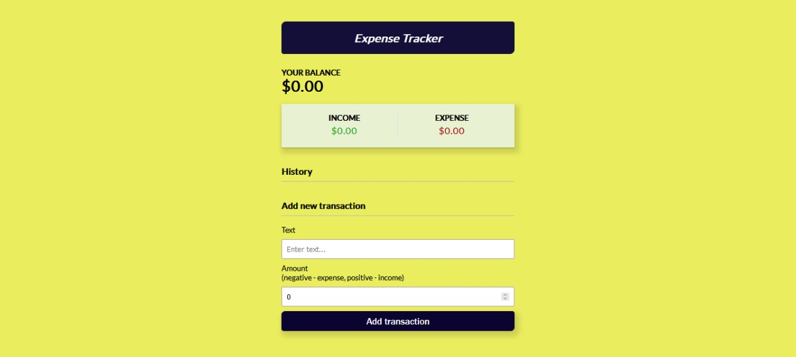
Home Page:-

Slide 10
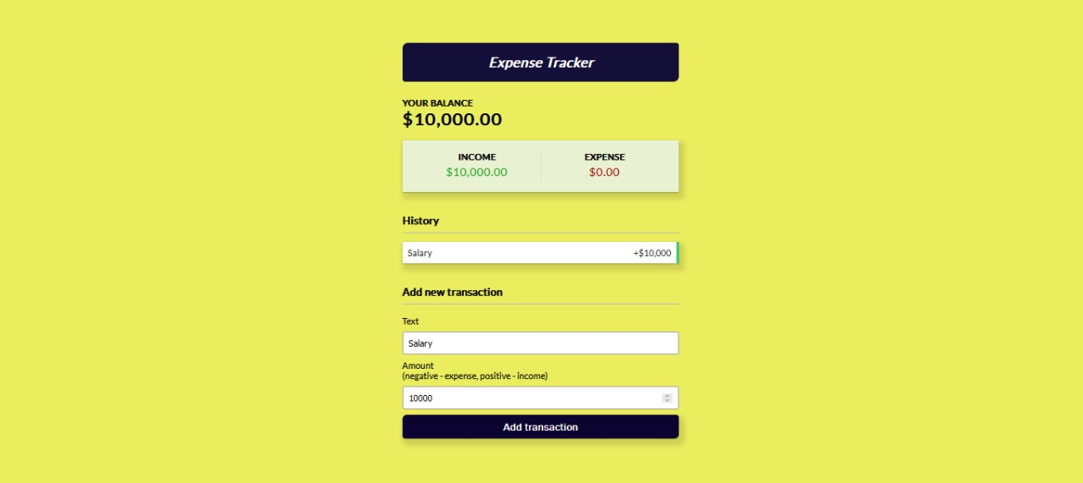
Adding Income:-

Slide 11
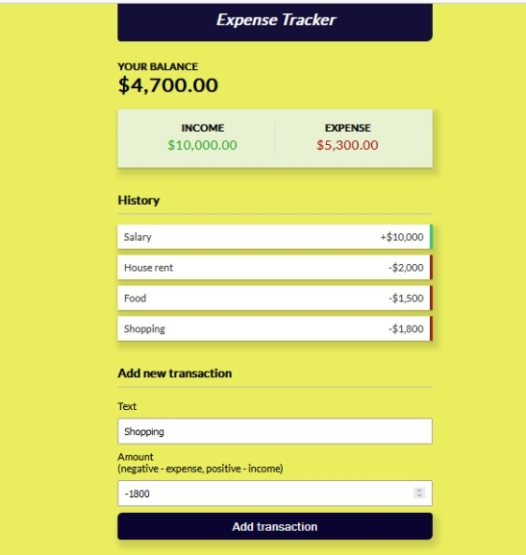
Transactions:-

Slide 12
Thank
You !!!

